Slide 1
COMPRESSION WITH BWT:-
The BWT algorithm has the ability to reconstruct the original data into a compressed data.
The major benefit of this implementation is that once the characters have been clustered together, they can have an effective ordering.
This makes our string a way more compressible for major algorithms like Huffman Coding , Move-to-front Transform and Run-length encoding.
The Burrows–Wheeler transform is an algorithm used to prepare data for use with data compression techniques such as bzip2.
The Burrows–Wheeler transform (BWT, also called block-sorting compression) rearranges a character string into runs of similar characters

Slide 2
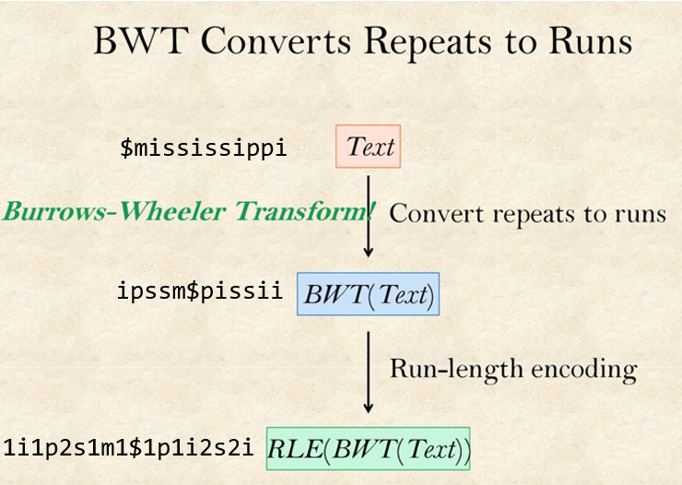

Slide 3
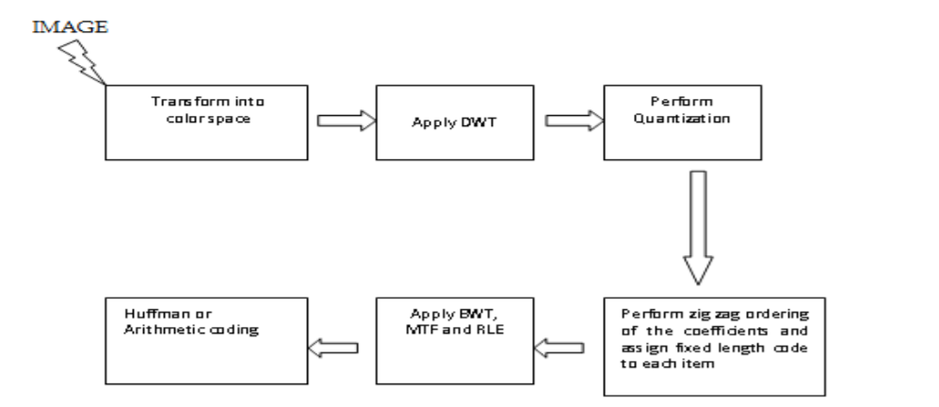
APPLICATIONS with BWT
IMAGE COMPRESSION:-

Slide 4
The ideal Burrows-Wheeler compression is quite slow due to sorting process and this is a major drawback of the process. Here, a new approach has been discussed in which BWT is applied before entropy encoding.
In this method, the image is first transformed into color-space, then the image components are divided into tiles, onedimensional DWT applied and quantization is performed. After quantization, instead of using Huffman or arithmetic coding, each of the quantized coefficients are assigned a number and then BWT transformation is applied.
With the use of BWT, data is transformed into formatted block of data which becomes easier to be compressed. MTE (Move to Front encoding) and RLE (Run length encoding) is performed on the data. The last step is compression of the image by the use of Huffman coding.

Slide 5
MOVE-TO-FRONT TRANSFORM:-
The move-to-front (MTF) transform is an encoding of data (typically a stream of bytes) designed to improve the performance of entropy encoding techniques of compression.
When efficiently implemented, it is fast enough that its benefits usually justify including it as an extra step in data compression algorithm
An important use of the MTF transform is in Burrows–Wheeler transform based compression. Compression benefits greatly from following up the BWT with an MTF transform before the final entropy-encoding step.

Slide 6
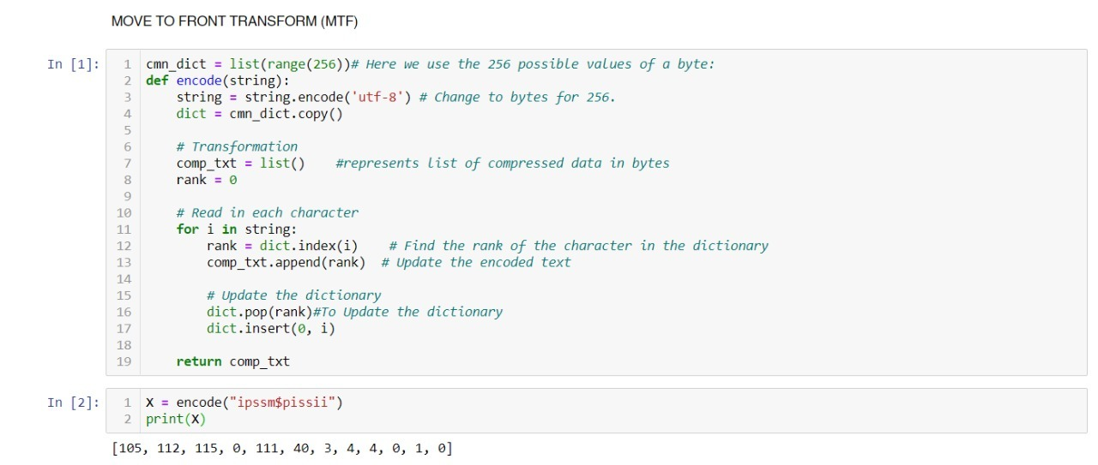

Slide 7
